Slide 1


Random Forest: The Versatile Machine Learning Algorithm
Random Forest is a powerful ensemble learning method that combines multiple decision trees to make accurate predictions. It's known for its versatility and ability to handle complex datasets.
by Lokesh Belekar

Slide 2

What is Random Forest?
1
Ensemble Learning
2
Decision Trees
Random Forest combines the predictions of multiple decision trees to improve accuracy and reduce overfitting.
Each decision tree in the forest independently learns from the data, making decisions based on features.
3
Voting
The final prediction is determined by a majority vote among the individual trees, resulting in a more robust outcome.

Slide 3
Key Components of Random Forest
Decision Trees
Bagging
Feature Randomness
Each tree is built using a random subset of features and data points, promoting diversity.
Bootstrap aggregating, or bagging, involves sampling with replacement to create multiple training sets.
At each node, a random subset of features is considered for splitting, preventing bias towards specific features.

Slide 4

Advantages of Random Forest
High Accuracy
Robustness
Feature Importance
Combines multiple trees, reducing variance and improving prediction accuracy.
Less prone to overfitting, handling noisy and complex datasets well.
Provides insights into the relative importance of features in the decision-making process.

Slide 5

When to use Random Forest?
Classification
Predicting categories, like spam detection or customer churn.
Regression
Predicting continuous values, like house prices or stock prices.
High Dimensional Data
Handling datasets with numerous features, effectively reducing noise.
Missing Values
Tolerant to missing values, offering robust performance.

Slide 6

How does Random Forest work?
1
Training
Multiple decision trees are trained on random subsets of data and features.
2
Prediction
For a new data point, each tree predicts a class or value, and the final prediction is based on a majority vote.
3
Ensemble
The combined predictions of all trees provide a more robust and accurate outcome.

Slide 7
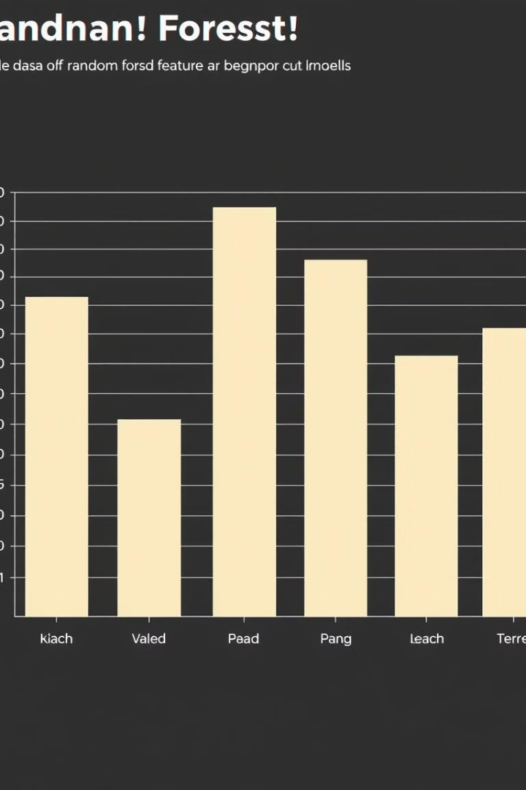



Feature Importance in Random Forest
Feature Importance
Measures how much each feature contributes to the accuracy of the model.
Feature Ranking
Provides a ranking of features, highlighting the most influential ones.
Insights
Helps understand which features are most relevant to the prediction task.

Slide 8




Hyperparameter Tuning in Random Forest
Number of Trees
Increasing the number of trees improves accuracy but also increases computation time.
Max Depth
Controls the complexity of individual trees, preventing overfitting.
Minimum Samples Split
Sets the minimum number of data points required to split a node, impacting tree structure.

Slide 9
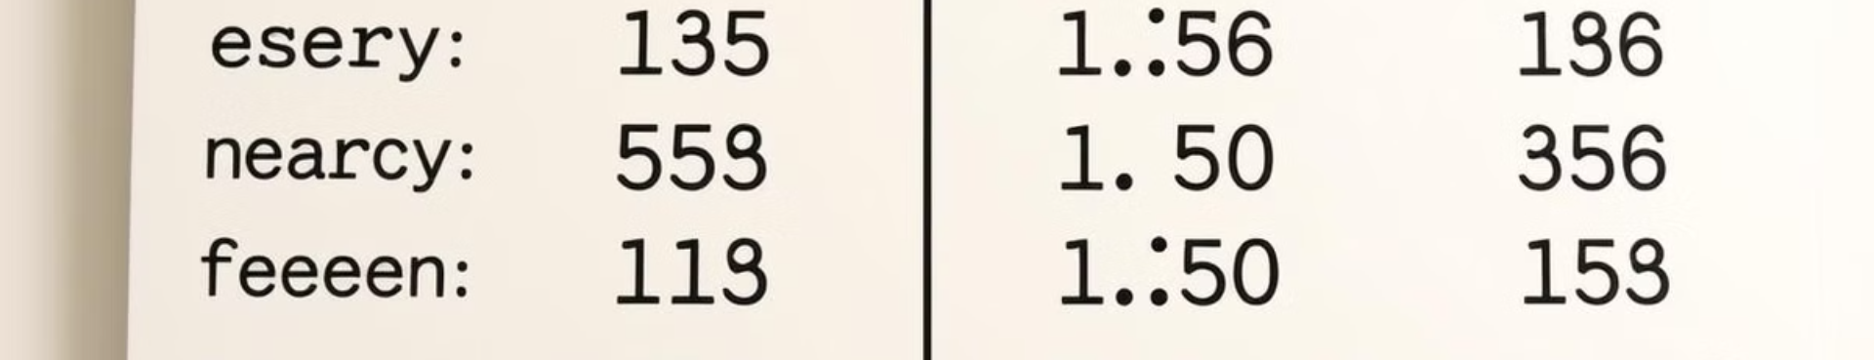
Evaluation Metrics for Random Forest
1
Accuracy
2
Precision
Percentage of correct predictions, suitable for balanced datasets.
Proportion of true positives among all predicted positives, important for minimizing false positives.
3
Recall
4
F1-Score
Proportion of true positives among all actual positives, crucial for identifying all positive instances.
Harmonic mean of precision and recall, balancing both metrics.

Slide 10

Interpreting Random Forest Results
Feature Importance
Model Performance
Business Impact
Understanding which features drive predictions is key to gaining insights and making informed decisions.
Evaluating accuracy, precision, and recall metrics provides a comprehensive assessment of model effectiveness.
Translating model results into actionable insights that can improve business operations and outcomes.

